Slide 1

STUDENT DETAILS
Name:B.DEVI
Email id: bonda.eee2020@vietvsp.com
College Name: VISAKHA INSTITUTE OF ENGINEERING & TECHNOLOGY
College state: ANDHRA PRADESH
Internship Domin: CYBER SECURITY (7/6/2023- 5/7/2023)

Slide 2

DOS ATTACK USING NS2

Slide 3

INTRODUCTION
A Denial of Service (DoS) attack refers to a malicious attempt to disrupt the availability or performance of a network service or website by overwhelming it with a flood of illegitimate requests or by exploiting vulnerabilities. NS2 (Network Simulator 2) is a widely used network simulation tool that can be utilized to study and analyze network protocols and their behavior.
To simulate a DoS attack using NS2, you can create a scenario where a large number of malicious nodes flood the target network with excessive traffic, consuming its resources and causing a denial of service. Here's a basic outline of the steps involved:
This Photo by Unknown author is licensed under CC BY-SA-NC.

Slide 4
OVERVIEW OF DOS ATTACK USING NS2
Network Topology Setup
Attack Model Selection
Traffic Generation
Protocol Configuration
Simulation Execution
Results and Analysis

Slide 5
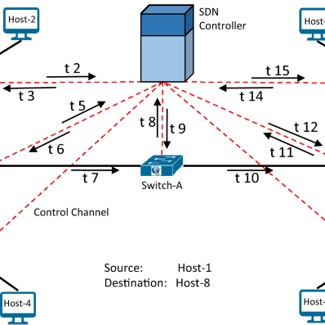
NETWORK TOPOLOGY
The network topology can vary depending on the specific scenario you want to simulate. For a basic example, let's consider a simple star topology where multiple nodes are connected to a central node. The central node can represent a server or a critical network resource that will be the target of the DoS attack.

Slide 6
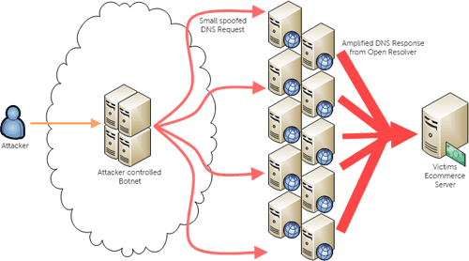
ATTACK MODEL
In the DoS attack simulation using NS2, the attack model involves generating a high volume of traffic towards the target node (central server) to exhaust its resources and disrupt its normal functioning. Specifically, we will discuss the chosen attack type, TCP flood, and FTP (File Transfer Protocol) flood.
TCP Flood: TCP (Transmission Control Protocol) flood is a type of DoS attack that targets the TCP protocol, which is widely used for reliable data transmission over the internet. In a TCP flood attack, the attacker overwhelms the target node with a flood of TCP connection requests, exhausting its resources and preventing legitimate users from establishing connections.
FTP (File Transfer Protocol) flood is another type of DoS attack that targets the FTP protocol, commonly used for file transfer between computers. In an FTP flood attack, the attacker floods the target node with a high volume of FTP control and data connection requests, overwhelming its capacity to handle these requests.
This Photo by Unknown author is licensed under CC BY-SA.

Slide 7
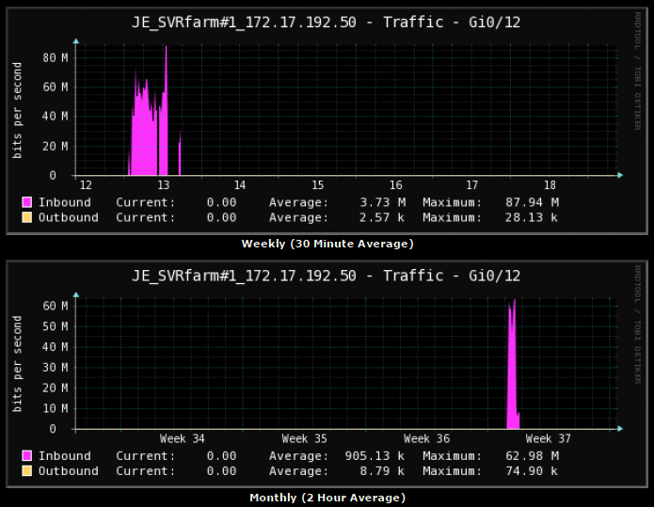
TRAFFIC GENERATION
In the DoS attack simulation using NS2, the traffic generation model determines how the attacking nodes generate and send packets towards the target node. The model influences the intensity and volume of the attack. Here's an explanation of the traffic generation model and how the packet generation rate affects the attack intensity:
Traffic Generation Model: The traffic generation model for the attacking nodes can be implemented using various approaches. Some common methods include:
Constant Rate
Bursty Traffic:
Random Traffic:

Slide 8
SIMULATION EXECUTION
Running a simulation in NS2 involves setting up the network scenario, defining protocols and parameters, and executing the simulation. Here's an overview of the process of running a simulation in NS2
Network Topology Setup:
Protocol Configuration:
Application and Traffic Generation:
Simulation Execution:
Post-simulation Analysis:

Slide 9
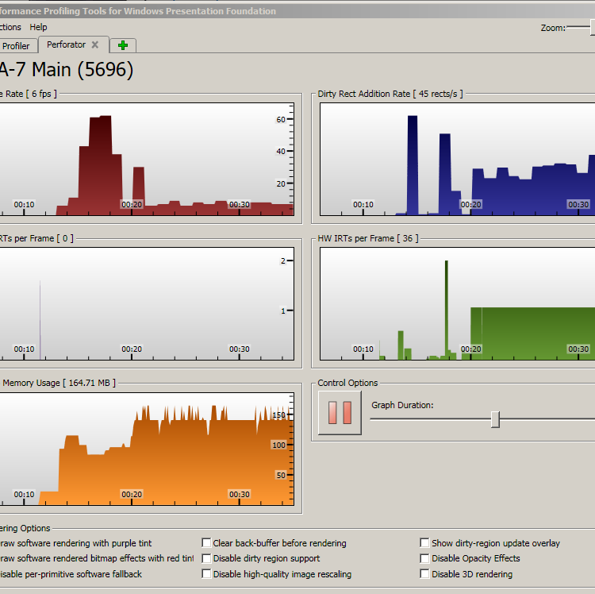
PERFORMANCE METRICS
When conducting a DoS attack simulation, several performance metrics can be used to evaluate the impact of the attack on the target node and the overall network. These metrics help in analyzing the effectiveness of the attack and assessing the vulnerabilities of the system. Here are some common performance metrics used in DoS attack simulations:
Packet Loss
Throughput
Response Time
CPU and Memory Utilization
Network Latency
Bandwidth Consumption
Service Availability

Slide 10
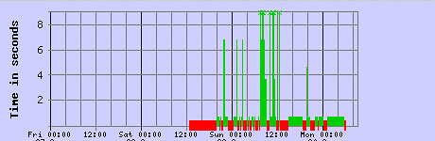

RESULTS AND ANALYSIS
When analyzing the results of a DoS attack simulation, it's important to examine various aspects to gain insights into the attack's impact on the target node and the overall network. Here are some key areas to focus on during the results and analysis phase
Analyze the CPU and memory utilization of the target node. Determine if the attack led to resource exhaustion or increased resource usage, affecting the node's ability to handle legitimate traffic.

Slide 11
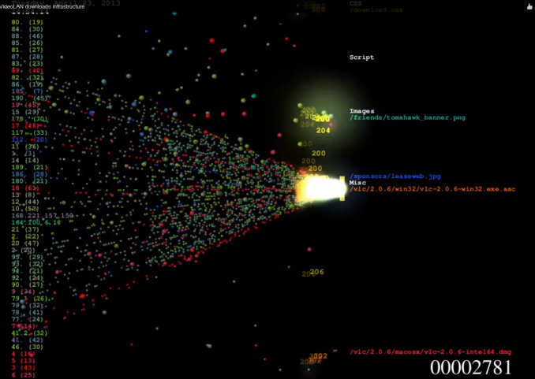
ETHICAL CONSIDERATIONS
It is crucial to highlight that real DoS attacks, without proper authorization, are illegal and unethical. Engaging in unauthorized activities that disrupt or impair the functioning of computer systems, networks, or services is a violation of laws and ethical standards.
DoS attacks can cause significant harm to individuals, businesses, and critical infrastructure. They can lead to financial losses, data breaches, service disruptions, and reputational damage. Therefore, it is essential to emphasize responsible and ethical use of NS2 or any other simulation tool for educational and research purposes only.
When using NS2 or any other network simulation tool, it should be done in a controlled and supervised environment with proper authorization and consent from relevant stakeholders. The purpose should be to understand the vulnerabilities, study attack techniques, develop defense mechanisms, and enhance network security.

Slide 12
CONCLUSION
In conclusion, simulating DoS attacks using NS2 provides a valuable platform for studying and understanding the impact of such attacks on network systems. By conducting responsible and authorized simulations, researchers can gain insights into the vulnerabilities of networks, develop effective defense mechanisms, and enhance overall network security.
Throughout the simulation, various aspects are considered, including network topology, attack models, traffic generation, and performance metrics. Analyzing the results helps identify the effects of the DoS attack on the target node and the network as a whole. It allows researchers to evaluate the effectiveness of defense mechanisms, assess the severity of the attack, and benchmark against industry standards.

Slide 13

REFERENCES
https://skillsbuild.edunetworld.com/courses/cs/dos-attack-using-ns2/
https://www.researchgate.net/publication/283550534_Impact_Evaluation_of_Distributed_Denial_of_Service_Attacks_using_NS2
https://networksimulator2.com/ns2-ddos-attack/
https://www.ncbi.nlm.nih.gov/pmc/articles/PMC6982801/

Slide 14

THANK YOU

